Slide 1


Sharing the Shield
Mastering the Art and Science of Cyber Threat Intelligence Exchange
Presenters: Nancy Lopez-Zapata
James Matthews
ISSA Raleigh Chapter
November 6, 2025

Slide 2

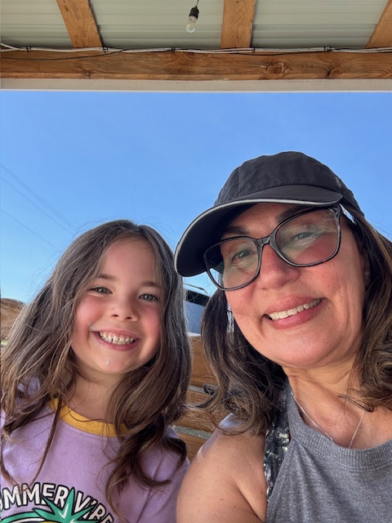
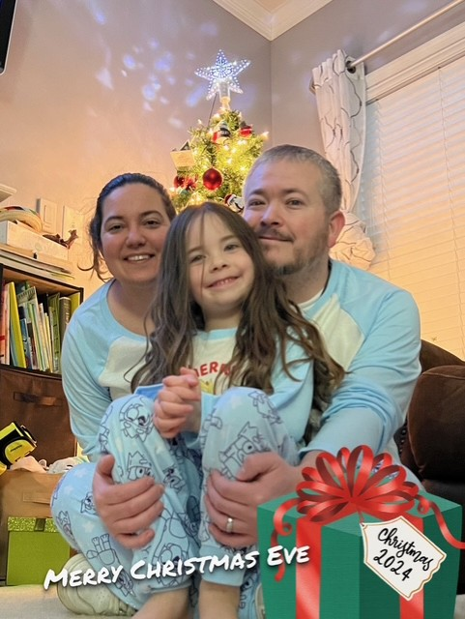
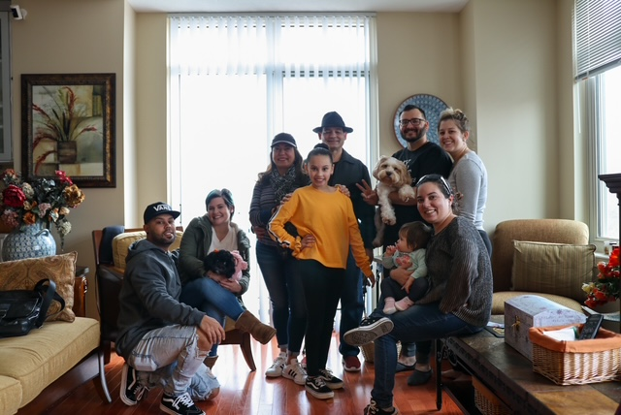



Who am I?
20+ Yrs Cybersecurity
DoW (a.k.a., DoD) & DHS
Project Manager
Information System Security
Agile Project Leadership
CISSP | CEH | Contract Officer Rep
Co-Founder of Align and Fortify, LLC
Mom, Wife, 2 Yorkies Mom, & Grandma
www.linkedin.com/in/nancy-lopez-zapata-9a989862
Notes:
Sources & References: (case studies and statistics cited in the speech)
Bright, T. Role of Cyber Threat Intelligence in Incident Response – Case of 2022 phishing campaign and CTI impact[7][6].
Cybersecurity & Infrastructure Security Agency – Advisory AA22-057A on destructive malware (Feb 2022)[8].
Cybersecurity Dive – MOVEit vulnerability compromises, 2023 (Clop ransomware campaign intel)[12][10].
Town of Apex, NC – Cyber Incident Report (2024) – NC Joint Cybersecurity Task Force engagement[13].
NCACC & CIS – MS-ISAC services for NC counties (2023)[21][22].
Hunton Andrews Kurth – North Carolina ransom ban law (2022)[1].
MITRE ATT&CK – v14 Update Changelog (Oct 2023)[4][5].
SANS Institute – AIS 2.0 OIG Report (2024) – CISA AIS upgrade to STIX/TAXII[20].
The Record – JCDC achievements (2022–2023), Log4j info sharing[23].
NIS2 Directive (EU 2022) – Article 29, Info-sharing requirements[31][32]. (Additional references from CISA, FIRST, and others were used for TLP 2.0, CIRCIA, and CRI details.)
[1] [15] North Carolina Becomes First State to Prohibit Public Entities from Paying Ransoms
https://www.hunton.com/privacy-and-information-security-law/north-carolina-becomes-first-state-to-prohibit-public-entities-from-paying-ransoms
[2] [3] [18] [24] [33] Speech Script.docx
file://file_000000001ff061f6b317316f65827380
[4] [5] Updates - Updates - October 2023 | MITRE ATT&CK®
https://attack.mitre.org/resources/updates/updates-october-2023/
[6] [7] [25] [26] Role of Cyber Threat Intelligence in Incident Response
https://www.brightdefense.com/resources/cyber-threat-intelligence-and-incident-response/
[8] Russian Cyber Threats to U.S. Critical Infrastructure | SecuLore
https://seculore.com/resources/russian-cyber-threats-to-u-s-critical-infrastructure/
[9] [10] [11] [12] What we know about the MOVEit vulnerabilities and compromises | Cybersecurity Dive
https://www.cybersecuritydive.com/news/moveit-vulnerability-compromises-what-we-know/652187/
[13] Cybersecurity Incident Information | Apex, NC - Official Website
https://www.apexnc.org/1983/Cybersecurity-Incident-Information
[14] [21] [22] Cyber Security - North Carolina Association of County Commissioners : North Carolina Association of County Commissioners
https://www.ncacc.org/services-for-counties/risk-management/cyber-security/
[16] [PDF] Cyber Incident Reporting for Critical Infrastructure Act of 2022 ... - CISA
https://www.cisa.gov/sites/default/files/2023-01/CIRCIA_07.21.2022_Factsheet_FINAL_508%20c.pdf
[17] Cyber Incident Reporting for Critical Infrastructure Act (CIRCIA ...
https://www.federalregister.gov/documents/2024/04/04/2024-06526/cyber-incident-reporting-for-critical-infrastructure-act-circia-reporting-requirements
[19] [PDF] Automated Indicator Sharing (AIS) Frequently Asked Questions (FAQs)
https://www.cisa.gov/sites/default/files/publications/AIS%2520FAQs%2520V2.0_508.pdf
[20] Reflections on the US Government’s OIG Report on CISA’s Automated Indicator Sharing Program | SANS Institute
https://www.sans.org/blog/reflections-on-the-us-governments-oig-report-on-cisas-automated-indicator-sharing-program
[23] [28] CISA’s Joint Cyber Defense Collaborative to tackle energy, water security in 2023 | The Record from Recorded Future News
https://therecord.media/cisas-joint-cyber-defense-collaborative-to-tackle-energy-water-security-in-2023
[27] Fortinet and the Joint Cyber Defense Collaborative: Celebrating Two ...
https://www.fortinet.com/blog/industry-trends/fortinet-and-the-jcdc-celebrating-two-years-of-progress
[29] CISA Gives Itself an Extension for Cyber Incident Reporting Rules
https://www.alstonprivacy.com/cisa-gives-itself-an-extension-for-cyber-incident-reporting-rules/
[30] About the CRI - International Counter Ransomware Initiative
https://counter-ransomware.org/aboutus
[31] [32] NIS 2 Directive, Article 29: Cybersecurity information-sharing arrangements
https://www.nis-2-directive.com/NIS_2_Directive_Article_29.html

Slide 3
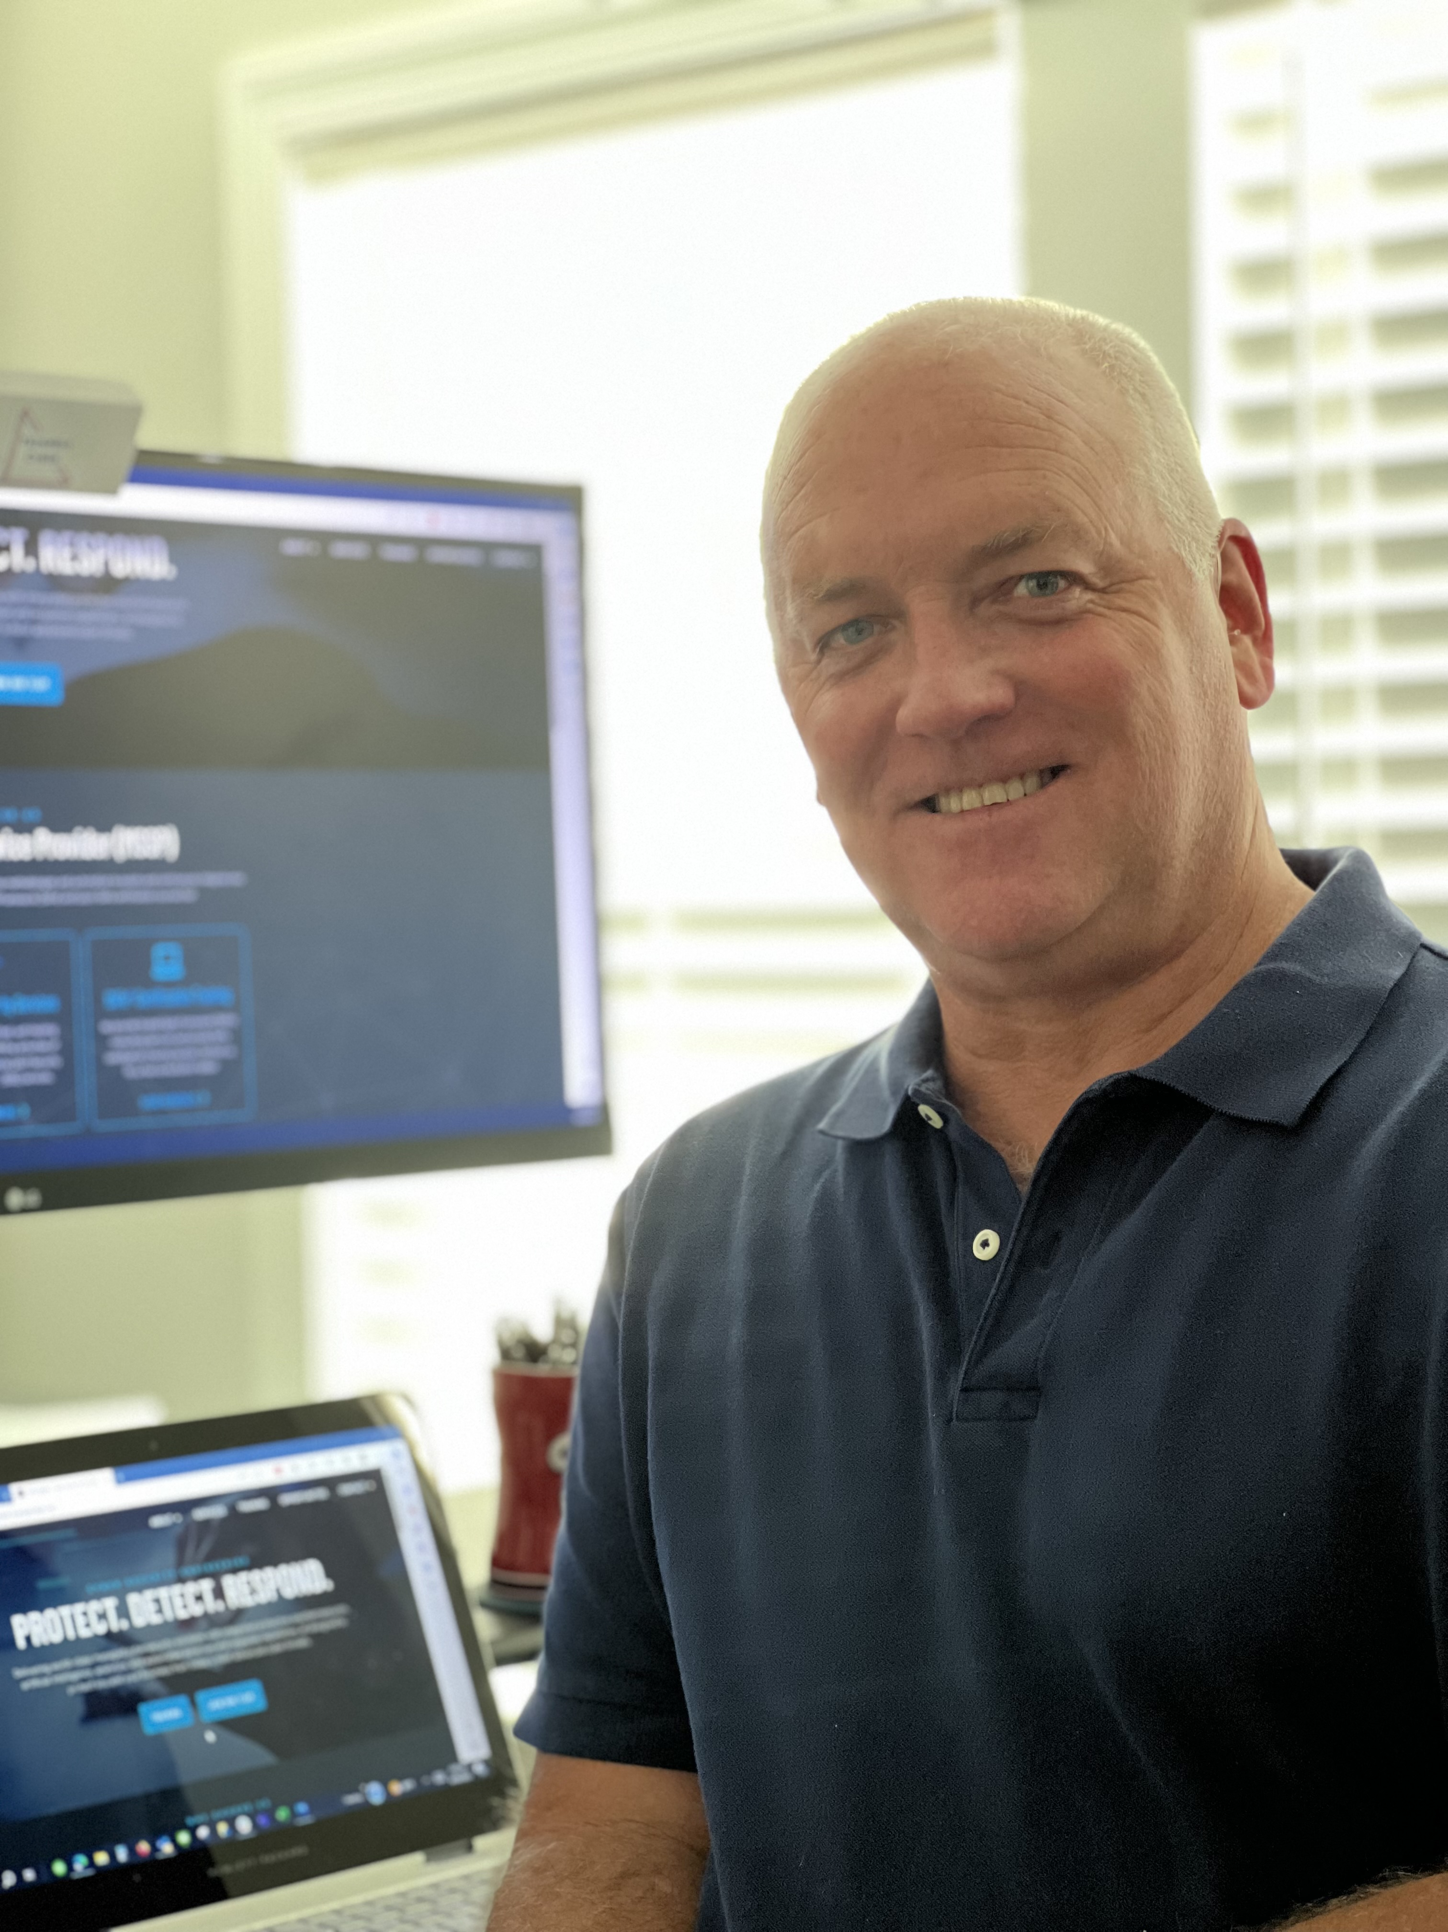

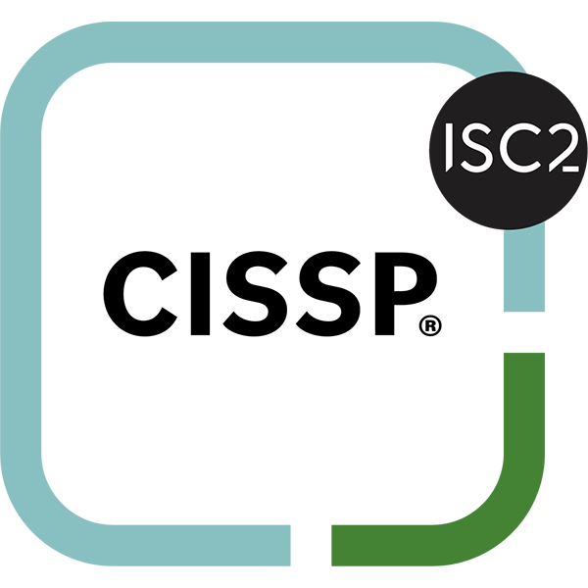

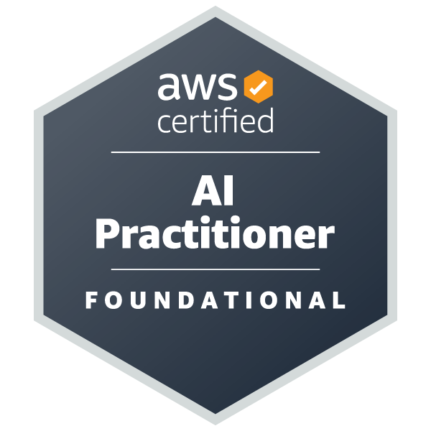



Who am I?
Co-Founder & President, Triangle Cyber, LLC
Chief Engineer/Architect, DHS CISA
Engineering Fellow, Raytheon Technologies
Naval Surface Warfare Center Dahlgren Division (NSWCDD)
Electrical Engineer, Systems Architect, Engineer/Integrator

Slide 4

From Isolation to Collective Defense
In cybersecurity, our greatest enemy isn't a single piece of malware—it's asymmetry. Attackers need to be right only once; defenders must be right every time.
The Problem
Isolated defenses leave everyone vulnerable to the same threats
For too long, we've played this game in isolation. When one organization suffers a breach, the Indicators Of Compromise (IOCs) are quietly contained while the same attackers leverage identical tactics against our peers.
The Solution
Collective defense through shared threat intelligence
The Impact
One organization's breach becomes everyone's shield

Slide 5

Speaking the Same Language: CTI & IOCs
Why This Matters?
To share cyber threat intelligence effectively, we need a common understanding of what we’re exchanging.
What is Cyber Threat Intelligence (CTI)?
Curated knowledge about adversaries: their motivations, methods, and intentions
Drawn from multiple sources, analyzed for actionability
Answers: “Who is attacking us, why, and how?”
What are Indicators of Compromise (IOCs)?
Clues left by attackers that help detect intrusions, in three key forms:
Atomic – Simple, fast indicators i.e., IP Address: 103.203.23.44
Computed – Data fingerprints i.e., SHA-256 Hash: a3b2c1d4e5f6...
Behavioral – Signs of attacker behavior i.e., Mutex Name: Global\\A1B2C3_Lock
Notes:
Sources & References: (case studies and statistics cited in the speech)
Bright, T. Role of Cyber Threat Intelligence in Incident Response – Case of 2022 phishing campaign and CTI impact[7][6].
Cybersecurity & Infrastructure Security Agency – Advisory AA22-057A on destructive malware (Feb 2022)[8].
Cybersecurity Dive – MOVEit vulnerability compromises, 2023 (Clop ransomware campaign intel)[12][10].
Town of Apex, NC – Cyber Incident Report (2024) – NC Joint Cybersecurity Task Force engagement[13].
NCACC & CIS – MS-ISAC services for NC counties (2023)[21][22].
Hunton Andrews Kurth – North Carolina ransom ban law (2022)[1].
MITRE ATT&CK – v14 Update Changelog (Oct 2023)[4][5].
SANS Institute – AIS 2.0 OIG Report (2024) – CISA AIS upgrade to STIX/TAXII[20].
The Record – JCDC achievements (2022–2023), Log4j info sharing[23].
NIS2 Directive (EU 2022) – Article 29, Info-sharing requirements[31][32]. (Additional references from CISA, FIRST, and others were used for TLP 2.0, CIRCIA, and CRI details.)
[1] [15] North Carolina Becomes First State to Prohibit Public Entities from Paying Ransoms
https://www.hunton.com/privacy-and-information-security-law/north-carolina-becomes-first-state-to-prohibit-public-entities-from-paying-ransoms
[2] [3] [18] [24] [33] Speech Script.docx
file://file_000000001ff061f6b317316f65827380
[4] [5] Updates - Updates - October 2023 | MITRE ATT&CK®
https://attack.mitre.org/resources/updates/updates-october-2023/
[6] [7] [25] [26] Role of Cyber Threat Intelligence in Incident Response
https://www.brightdefense.com/resources/cyber-threat-intelligence-and-incident-response/
[8] Russian Cyber Threats to U.S. Critical Infrastructure | SecuLore
https://seculore.com/resources/russian-cyber-threats-to-u-s-critical-infrastructure/
[9] [10] [11] [12] What we know about the MOVEit vulnerabilities and compromises | Cybersecurity Dive
https://www.cybersecuritydive.com/news/moveit-vulnerability-compromises-what-we-know/652187/
[13] Cybersecurity Incident Information | Apex, NC - Official Website
https://www.apexnc.org/1983/Cybersecurity-Incident-Information
[14] [21] [22] Cyber Security - North Carolina Association of County Commissioners : North Carolina Association of County Commissioners
https://www.ncacc.org/services-for-counties/risk-management/cyber-security/
[16] [PDF] Cyber Incident Reporting for Critical Infrastructure Act of 2022 ... - CISA
https://www.cisa.gov/sites/default/files/2023-01/CIRCIA_07.21.2022_Factsheet_FINAL_508%20c.pdf
[17] Cyber Incident Reporting for Critical Infrastructure Act (CIRCIA ...
https://www.federalregister.gov/documents/2024/04/04/2024-06526/cyber-incident-reporting-for-critical-infrastructure-act-circia-reporting-requirements
[19] [PDF] Automated Indicator Sharing (AIS) Frequently Asked Questions (FAQs)
https://www.cisa.gov/sites/default/files/publications/AIS%2520FAQs%2520V2.0_508.pdf
[20] Reflections on the US Government’s OIG Report on CISA’s Automated Indicator Sharing Program | SANS Institute
https://www.sans.org/blog/reflections-on-the-us-governments-oig-report-on-cisas-automated-indicator-sharing-program
[23] [28] CISA’s Joint Cyber Defense Collaborative to tackle energy, water security in 2023 | The Record from Recorded Future News
https://therecord.media/cisas-joint-cyber-defense-collaborative-to-tackle-energy-water-security-in-2023
[27] Fortinet and the Joint Cyber Defense Collaborative: Celebrating Two ...
https://www.fortinet.com/blog/industry-trends/fortinet-and-the-jcdc-celebrating-two-years-of-progress
[29] CISA Gives Itself an Extension for Cyber Incident Reporting Rules
https://www.alstonprivacy.com/cisa-gives-itself-an-extension-for-cyber-incident-reporting-rules/
[30] About the CRI - International Counter Ransomware Initiative
https://counter-ransomware.org/aboutus
[31] [32] NIS 2 Directive, Article 29: Cybersecurity information-sharing arrangements
https://www.nis-2-directive.com/NIS_2_Directive_Article_29.html

Slide 6



The Pyramid of Pain
Not all indicators are equal. The value of intelligence we share is directly related to how much pain it causes
adversaries when we act on it.
Tools, Techniques, & Procedures (TTPs)
1
High Pain: Forces attackers to alter entire playbook
Example: Suspicious mutex name like “Global\A1B2C3_Lock”
Domain Names
Network & Host Artifacts
2
Medium Pain: Requires infrastructure changes
Medium Pain: Harder to change mid-campaign
Hash Values
IP Addresses
3
Low Pain: Easy to recompile malware
Low Pain: Trivial to rotate
We need to move up the pyramid in our sharing focus. By sharing richer intelligence (i.e., context around how adversaries operate) we impose high pain on attackers and enable proactive defense.

Slide 7



Why Sharing is Non-Negotiable
Compress Detection Time
Build the Bigger Picture
Multiply Resources
Organizations using threat intel sharing see 40% reduction in detection time and 45% reduction in response time.
When Organization A detects a new IOC today, Organization B can deploy defenses within minutes.
An isolated IOC is a puzzle piece without the box.
By aggregating indicators across organizations, patterns emerge revealing campaigns, TTPs, and even attribution to threat actors.
Why should 100 security teams each analyze the same malware?
Through sharing, we centralize heavy lifting one team's analysis yields industry-wide defensive value.

Slide 8
Real-World Impact: CTI Sharing Saves the Day
2022: Financial Phishing Blitz
1
One bank identified phishing indicators and shared via FS-ISAC. Result: Banks across the country, including Charlotte's banking hub, blocked malicious domains within hours, drastically cutting potential losses.
2
2022: Ukraine Wiper Malware
Ukrainian victims shared intel on destructive malware (WhisperGate, HermeticWiper). CISA issued urgent advisory. Result: Global critical infrastructure fortified defenses before malware could spread.
2023: MOVEit Zero-Day
3
Clop ransomware exploited MOVEit vulnerability affecting thousands. CISA, FBI, Microsoft, Mandiant, and CrowdStrike collaborated openly. Result: Rapid patching and hunting prevented widespread disaster.
4
2024: Apex, NC Ransomware
Town of Apex activated NC Joint Cybersecurity Task Force. Result: Within days, adversary was eradicated. Intel shared with municipalities statewide via Multi State-Information Sharing and Analysis Center (MS-ISAC), turning one town's compromise into every town's lesson.

Slide 9
Breaking Down the Barriers
Legal & Regulatory
Trust & Reliability
Technical Incompatibility
Privacy laws (GDPR, CCPA) limit data sharing
Source credibility concerns
False positive risks
Different systems and formats
Anti-trust concerns among competitors
Reputation damage fears
Data silos and manual processes
Solution: Build vetted communities State-Information Sharing and Analysis Center (ISACs), use Traffic Light Protocol (TLP), establish formal agreements
Inconsistent classifications
Fear of liability or regulatory backlash
Solution: Adopt standards (STIX/TAXII), use common frameworks (MITRE ATT&CK)
Solution: Anonymize data, leverage CISA Act protections, encourage entities to report under the Cyber Incident Reporting for Critical Infrastructure Act of 2022 (CIRCIA)
Notes:
While covered cyber incident and ransomware payment reporting under CIRCIA will not be required until the CIRCIA Final Rule goes into effect, CISA encourages all entities to voluntarily share with CISA information on cyber incidents prior to the effective date of the Final Rule.
When information about cyber incidents is shared quickly, CISA can use this information to render assistance and provide warning to prevent other organizations from falling victim to a similar incident. This information is also critical to identifying trends that can help efforts to protect the homeland.

Slide 10




The Language of Threat Intelligence
UTUBE: What Are STIX/TAXII?
STIX 2.1
Structured Threat Information eXpression: the common language for CTI. Encodes indicators, attack patterns, malware, campaigns, and threat actors with rich context.
Example of objects for things (package): “IP address 5.6.7.8 was observed as a command-and-control server used by Malware X, associated with the campaign ‘Holiday Hack,’ and the attackers used ATT&CK technique T1048 (Exfiltration over Alternate Protocol) to steal data.”
TAXII 2.1
Trusted Automated eXchange: the delivery system (clients & servers). Secure highway for machine-to-machine sharing, enabling real-time automated intelligence pipelines. It’s the plumbing that makes real-time sharing feasible.
Open Tools
Malware Indicators Sharing Platform (MISP), YARA rules, Sigma queries: Community-driven tools that translate intel into directly usable detection logic.
With STIX/TAXII, one analyst's discovery can traverse the pipeline and land in another's detection stack within seconds, completed with all structured context.
Notes:
What Are STIX/TAXII?

Slide 11
How to Share Effectively
Sector-Specific ISACs/ISAOs
1
Industry-specific trust groups (FS-ISAC for finance, MS-ISAC for government). All 100 NC counties access MS-ISAC's 24/7 monitoring and threat advisories through CIS partnership.
Vendor Intelligence Feeds
2
Mandiant, CrowdStrike, Cisco Talos provide automated threat updates. High volume but often lower Pyramid of Pain indicators—good baseline for known threats.
Government Collaboration
3
CISA, FBI, and Joint Cyber Defense Collaborative (JCDC) share critical infrastructure threats. NC's Joint Cybersecurity Task Force exemplifies state-level coordination.
Traffic Light Protocol
4
TLP labels (RED , AMBER , GREEN , CLEAR ) set sharing boundaries. Simple schema builds trust by establishing clear rules for information handling.
MS-ISAC: Multi-State Information Sharing and Analysis Center (MS-ISAC) / FS-ISAC: Financial Services- Information Sharing and Analysis Center (FS-ISAC)

Slide 12
From Intel to Action: The CTI Workflow
01
02
Ingestion
Normalization
Automatically pull CTI feeds into Threat Intelligence Platform or SIEM
Eliminate duplicates and standardize data into common schema
03
04
Vetting & Scoring
Enrichment
Apply confidence scores based on source trust and relevance
Add context—geoIP, malware family, MITRE ATT&CK mapping
-> Example: “Command-and-control server in X country, tied to TrickBot, using ATT&CK technique T1071.”
05
06
Deployment
Feedback Loop
Push high-confidence IOCs to firewalls, EDR, email filters automatically
Report false positives and successful detections back to community
*** Mature SOCs integrate CTI with SOAR tools to automate this workflow - from ingestion to
deployment in seconds, not hours.

Slide 13
Essential Skill Set for a Cyber Threat Intelligence (CTI) Analyst
Skill Pillar | Key Competency | Short Description
Analytical & Critical Thinking | In-Depth Analysis | Ability to gather, interpret, and connect vast amounts of raw data (IOCs, dark web chatter, logs) to identify patterns and threat actor campaigns.
 | Critical Reasoning | Formulating unbiased judgments and evidence-based conclusions, identifying logical fallacies or biases in information.
 | Investigative Mindset | Possessing the curiosity and persistence to "pivot" on data points to uncover the who, why, and how behind a cyberattack.
Technical Proficiency | Threat Models & Frameworks | Expert knowledge of models like MITRE ATT&CK, Cyber Kill Chain, and the Diamond Model to structure and classify adversary TTPs.
 | Network & Security Concepts | Solid understanding of networking protocols, intrusion detection systems, malware behavior, and security technologies (e.g., SIEM, TIPs).
 | OSINT & Collection | Proficiency in Open-Source Intelligence (OSINT) gathering, dark web research, and leveraging intelligence platforms and feeds.
Communication & Reporting | Stakeholder Communication | Translating highly technical intelligence findings into clear, concise, and actionable recommendations for both technical teams and non-technical executives.
 | Intelligence Tradecraft | Writing formal intelligence reports that adhere to established criteria (e.g., timeliness, relevance, and accuracy) and effectively disseminate intelligence.
Professional Effectiveness | Continuous Learning | A commitment to constantly stay updated on emerging threat actors, new vulnerabilities, and evolving attacker methodologies.
 | Adaptability & Collaboration | The ability to quickly pivot research priorities based on current events and collaborate effectively with Incident Response and SOC teams.

Slide 14
Evolving CTI Landscape (2024–2025)
Smarter Standards and Interoperability
STIX and TAXII 2.1
Collaborative Automated Course of Action Operations (CACAO)
Open Cybersecurity Schema Framework (OCSF)
Frameworks Getting Sharper
MITRE ATT&CK & D3FEND
Policy and Global Collaboration
The Joint Cyber Defense Collaborative (JCDC)
Cyber Incident Reporting for Critical Infrastructure Act (CIRCIA)
Right Here in North Carolina
NC Joint Cybersecurity Task Force

Slide 15
The Future is Federated
Together We Are Stronger
40%
Key Actions
Faster Detection
1. Adopt Standards: Use STIX/TAXII to automate and enrich intel exchange
Reduction in Mean time to Detect with CTI sharing
2. Join Trust Networks: Participate in ISACs and leverage TLP frameworks
3. Automate Defenses: Configure security stacks to act on shared intel in real-time
45%
4. Foster Sharing Culture: Celebrate analysts who contribute back to the community
Faster Response
Reduction in Mean Time to Respond
200+
"By sharing our shields, we transform isolated defenses into a collective fortress. Every time you share a threat indicator, you're potentially preventing a breach somewhere."
ATT&CK Techniques
Enterprise techniques mapped for shared understanding
Here in Raleigh and across North Carolina, we have the opportunity to lead by example. Let's make our region notably harder for adversaries to operate in - where one company's detection becomes every company's defense the same day.

Slide 16
Sources & References: (case studies and statistics cited in the speech)
Bright, T. Role of Cyber Threat Intelligence in Incident Response – Case of 2022 phishing campaign and CTI impact[7][6].
Cybersecurity & Infrastructure Security Agency – Advisory AA22-057A on destructive malware (Feb 2022)[8].
Cybersecurity Dive – MOVEit vulnerability compromises, 2023 (Clop ransomware campaign intel)[12][10].
Town of Apex, NC – Cyber Incident Report (2024) – NC Joint Cybersecurity Task Force engagement[13].
NCACC & CIS – MS-ISAC services for NC counties (2023)[21][22].
Hunton Andrews Kurth – North Carolina ransom ban law (2022)[1].
MITRE ATT&CK – v14 Update Changelog (Oct 2023)[4][5].
SANS Institute – AIS 2.0 OIG Report (2024) – CISA AIS upgrade to STIX/TAXII[20].
The Record – JCDC achievements (2022–2023), Log4j info sharing[23].
NIS2 Directive (EU 2022) – Article 29, Info-sharing requirements[31][32]. (Additional references from CISA, FIRST, and others were used for TLP 2.0, CIRCIA, and CRI details.)
[1] [15] North Carolina Becomes First State to Prohibit Public Entities from Paying Ransoms
https://www.hunton.com/privacy-and-information-security-law/north-carolina-becomes-first-state-to-prohibit-public-entities-from-paying-ransoms
[2] [3] [18] [24] [33] Speech Script.docx
file://file_000000001ff061f6b317316f65827380
[4] [5] Updates - Updates - October 2023 | MITRE ATT&CK®
https://attack.mitre.org/resources/updates/updates-october-2023/
[6] [7] [25] [26] Role of Cyber Threat Intelligence in Incident Response
https://www.brightdefense.com/resources/cyber-threat-intelligence-and-incident-response/
[8] Russian Cyber Threats to U.S. Critical Infrastructure | SecuLore
https://seculore.com/resources/russian-cyber-threats-to-u-s-critical-infrastructure/
[9] [10] [11] [12] What we know about the MOVEit vulnerabilities and compromises | Cybersecurity Dive
https://www.cybersecuritydive.com/news/moveit-vulnerability-compromises-what-we-know/652187/
[13] Cybersecurity Incident Information | Apex, NC - Official Website
https://www.apexnc.org/1983/Cybersecurity-Incident-Information
[14] [21] [22] Cyber Security - North Carolina Association of County Commissioners : North Carolina Association of County Commissioners
https://www.ncacc.org/services-for-counties/risk-management/cyber-security/
[16] [PDF] Cyber Incident Reporting for Critical Infrastructure Act of 2022 ... - CISA
https://www.cisa.gov/sites/default/files/2023-01/CIRCIA_07.21.2022_Factsheet_FINAL_508%20c.pdf
[17] Cyber Incident Reporting for Critical Infrastructure Act (CIRCIA ...
https://www.federalregister.gov/documents/2024/04/04/2024-06526/cyber-incident-reporting-for-critical-infrastructure-act-circia-reporting-requirements
[19] [PDF] Automated Indicator Sharing (AIS) Frequently Asked Questions (FAQs)
https://www.cisa.gov/sites/default/files/publications/AIS%2520FAQs%2520V2.0_508.pdf
[20] Reflections on the US Government’s OIG Report on CISA’s Automated Indicator Sharing Program | SANS Institute
https://www.sans.org/blog/reflections-on-the-us-governments-oig-report-on-cisas-automated-indicator-sharing-program
[23] [28] CISA’s Joint Cyber Defense Collaborative to tackle energy, water security in 2023 | The Record from Recorded Future News
https://therecord.media/cisas-joint-cyber-defense-collaborative-to-tackle-energy-water-security-in-2023
[27] Fortinet and the Joint Cyber Defense Collaborative: Celebrating Two ...
https://www.fortinet.com/blog/industry-trends/fortinet-and-the-jcdc-celebrating-two-years-of-progress
[29] CISA Gives Itself an Extension for Cyber Incident Reporting Rules
https://www.alstonprivacy.com/cisa-gives-itself-an-extension-for-cyber-incident-reporting-rules/
[30] About the CRI - International Counter Ransomware Initiative
https://counter-ransomware.org/aboutus
[31] [32] NIS 2 Directive, Article 29: Cybersecurity information-sharing arrangements
https://www.nis-2-directive.com/NIS_2_Directive_Article_29.html

