Slide 1
ISSA Career Services Ask me Anything pre-presentation
Dan Greenhaus

Slide 2
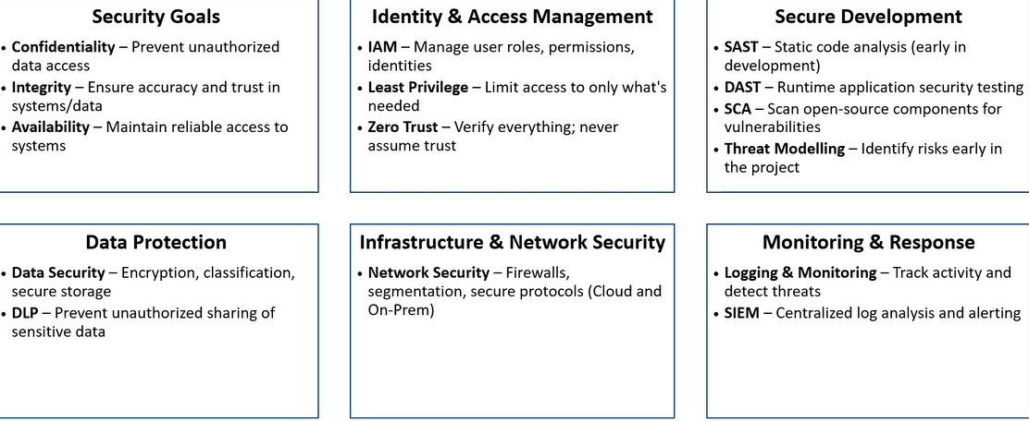
Cyber Security Focus areas

Slide 3
What are you doing?
Learning creates knowledge
Practice creates skills
Together, these lead to mastery

Slide 4
Local IT and Security Meetup Groups
Raleigh ISSA
Raleigh Triangle Chapter ISACA
Research Triangle PowerShell Users Group
Cloud Security Alliance Triangle Chapter
Raleigh Cyber Security for Control Systems
Triangle Linux Users Group
Triangle Linux Users Group website
AI - RTP
DefCon919
RTP Security Beers
WiCyS North Carolina Affiliate
Raleigh Red Hat User Group
Raleigh Identity & Access Management
Data, Cloud and AI in Raleigh
Triangle AWS User Group
RTP Programmability and Automation Meetup
Ansible4Networking
All things open RTP Meetup
2600

