Slide 1
Positioning yourself …when you don’t have skills
March 3rd, 2025
Evan Strickland Cisco - Technical Leader

Slide 2
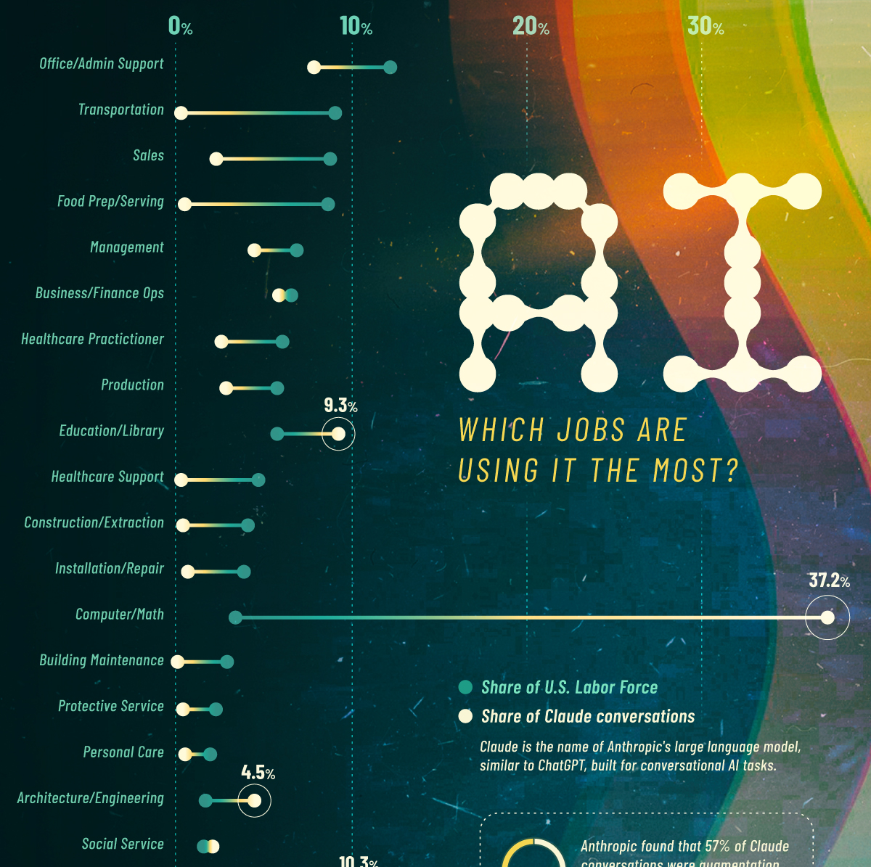
The landscape is shifting
Notes:
https://www.visualcapitalist.com/charted-which-jobs-are-using-ai-the-most/

Slide 3
Notes:
https://www.theregister.com/2025/03/03/cybersecurity_jobs_market/
https://www.visualcapitalist.com/charted-which-jobs-are-using-ai-the-most/
https://www.dreamstime.com/man-desperately-reaches-money-crumbling-cliff-edge-as-rocks-fall-man-desperately-reaches-money-crumbling-cliff-edge-image332825183

Slide 4
300 million jobs could be lost to AI
44% of companies using or planning on using AI believe it will result in layoffs in 2024
By the end of the decade, 14% of workers will have been forced by AI to change career
14% of all workers have been displaced from their jobs by AI
60% of the jobs in advanced economies are at risk of being replaced by AI
But just 26% of jobs in low-income countries are similarly exposed
24% of all workers are worried that AI will soon make their job obsolete
Workers aged 18-24 are 129% more likely than workers aged over 65 to worry that AI will make their job obsolete
15% of workers in the US would consider having an AI boss
Notes:
https://explodingtopics.com/blog/ai-replacing-jobs

Slide 5
Gain Composure
What DO I Do?
How has success in your current job brought more skills?
Of the people you’ve met, who seems cool?
What skills can be served in another kind of role?
How do you solve problems?
Notes:
Reference: https://spiritualearth.com/wp-content/uploads/2019/07/inner-peace.jpg

Slide 6
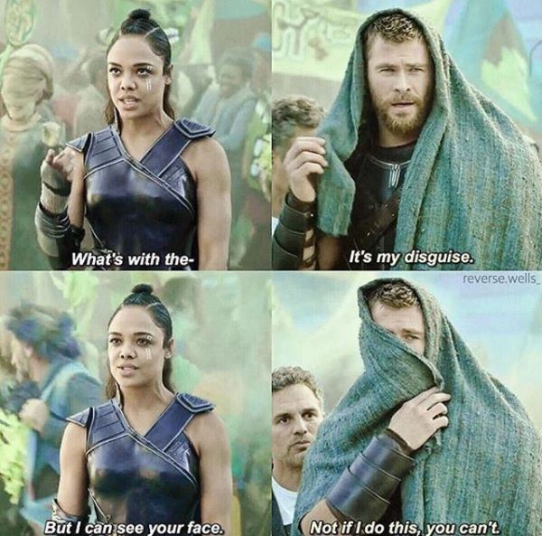
How to be a chameleon
Ask for the wisdom from an expert in a job you want, not the education
Don’t focus on the requirements, focus on the needs
Talk, talk and talk some more to anyone and everyone in the job you want
Once you have a good understand of the job, then seek education
Notes:
https://imgflip.com/memegenerator/280350242/Thor-not-if-i-do-this

Slide 7
Get wisdom
A job has requirements, but we work with people who must have some level of trust with each other (What can I never forget in this job?)
Understanding that trust first starts with being able to ”speak the language” (What’s the thing you wish people knew more about?)
When jargon fails, war stories prevail (What sucks at your job?)
Notes:
https://imgflip.com/memegenerator/280350242/Thor-not-if-i-do-this

Slide 8
Not requirements, but needs
Careers aren’t built by what’s advertised (What is the company building that requires this position?)
Careers are sustained by adaptability (What market insights can I get in this industry?)
Being inquisitive, at the right time, identifies those needs (What problems are left unsolved, but drive a lot of complaints)
Notes:
https://floralnarrative.medium.com/we-are-like-ships-in-the-night-8aaeaacc7aba

Slide 9
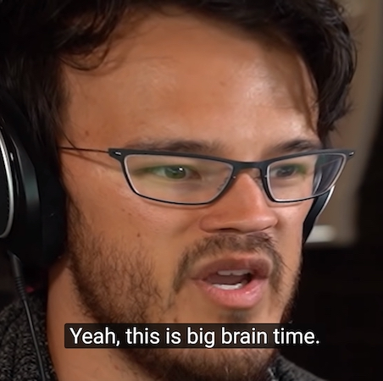
Talk, talk, and talk some more
First sit and learn from someone who knows
Who does this kind of work?
What does it mean to be successful?
What worries you about this line of work?
Where do you get your knowledge?
After you learn something interesting, share it with a small audience to see if you got it right. Then a big audience
Notes:
https://en.meming.world/wiki/File:Yeah,_This_Is_Big_Brain_Time.jpg/

Slide 10
War Stories
Experts cannot remember everything, but generally have 3-5 stories that they reference that defined their career
What changed the way you thought about this line of work?
What was the biggest change you’ve seen in your career?
What experience taught you the most?
How did something you did well or badly change the way you work?
Notes:
https://www.pcgamer.com/helldivers-2-xp-farm/

Slide 11
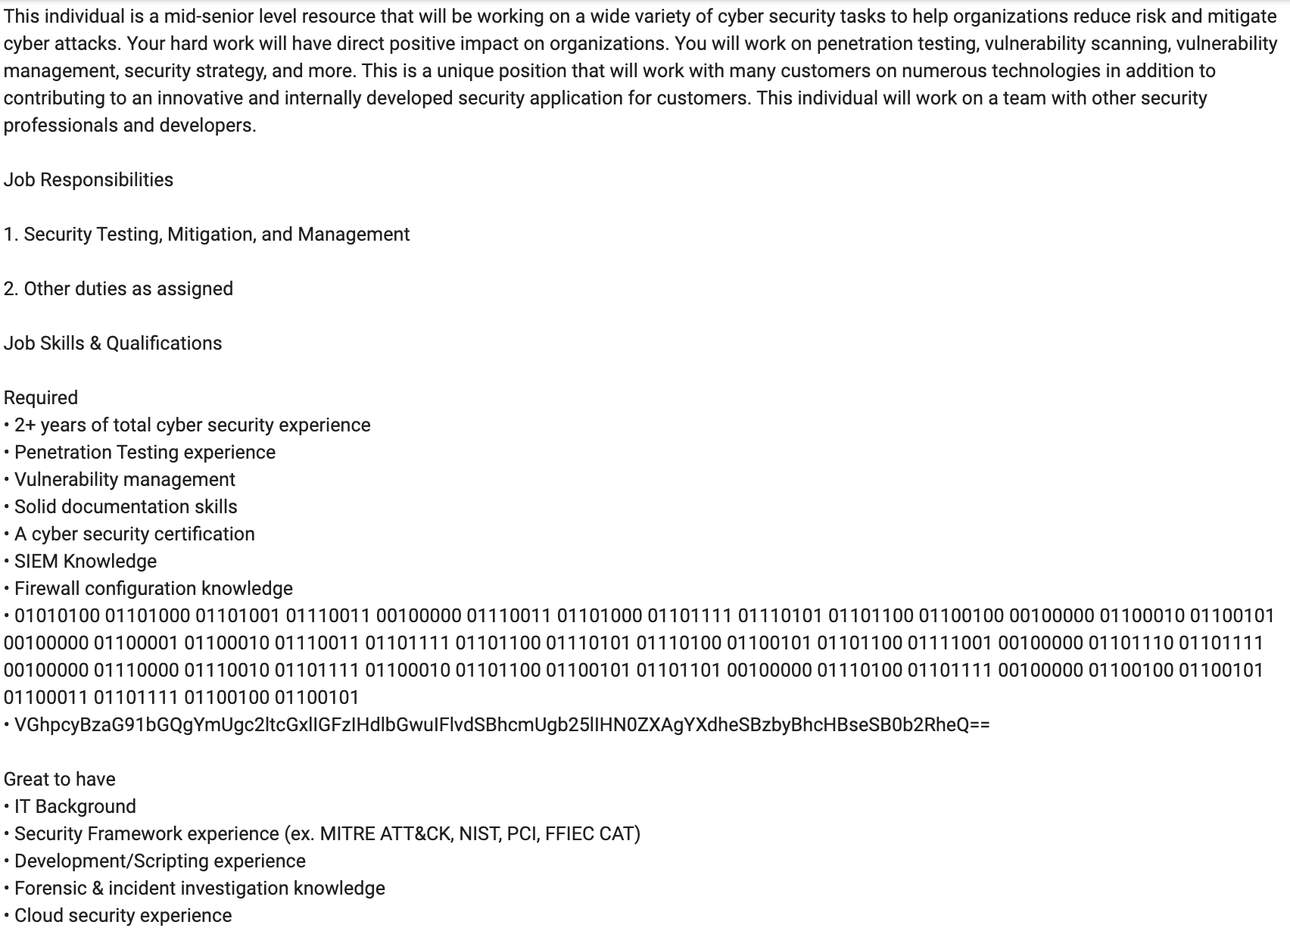
Interpreting the Job Description Understand Audience
It might be worth replying in binary or base64

Slide 12
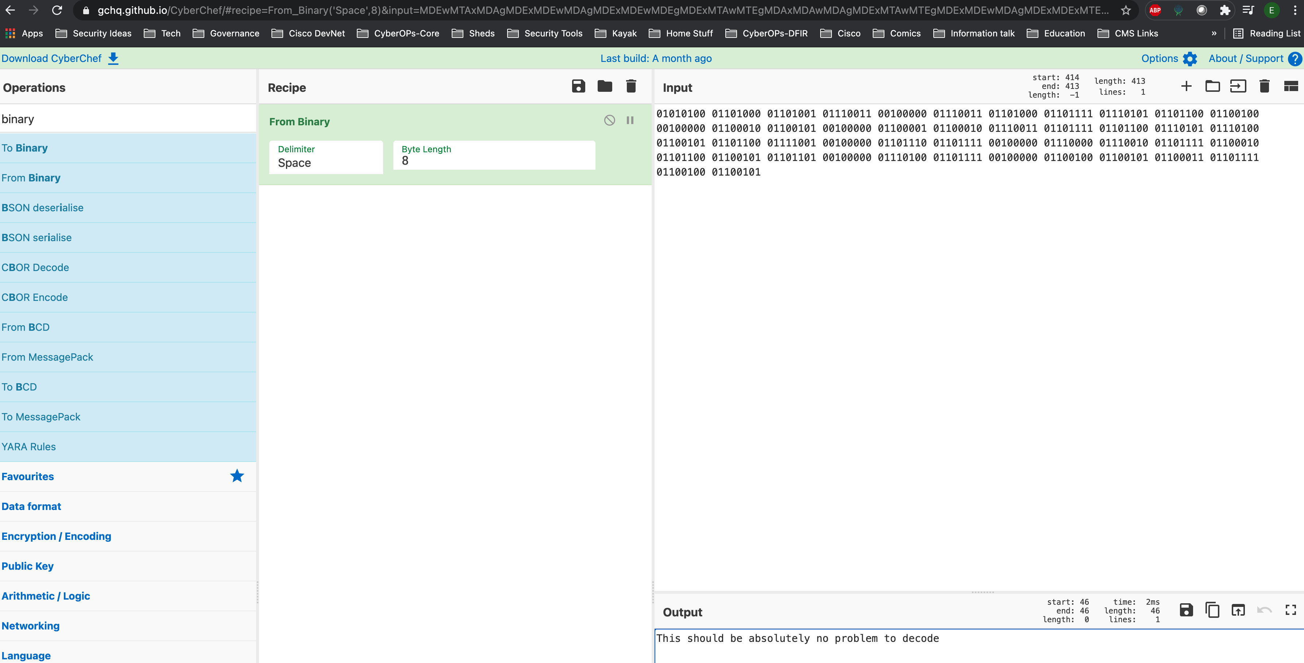
Looking at the Job Description strange new world

Slide 13
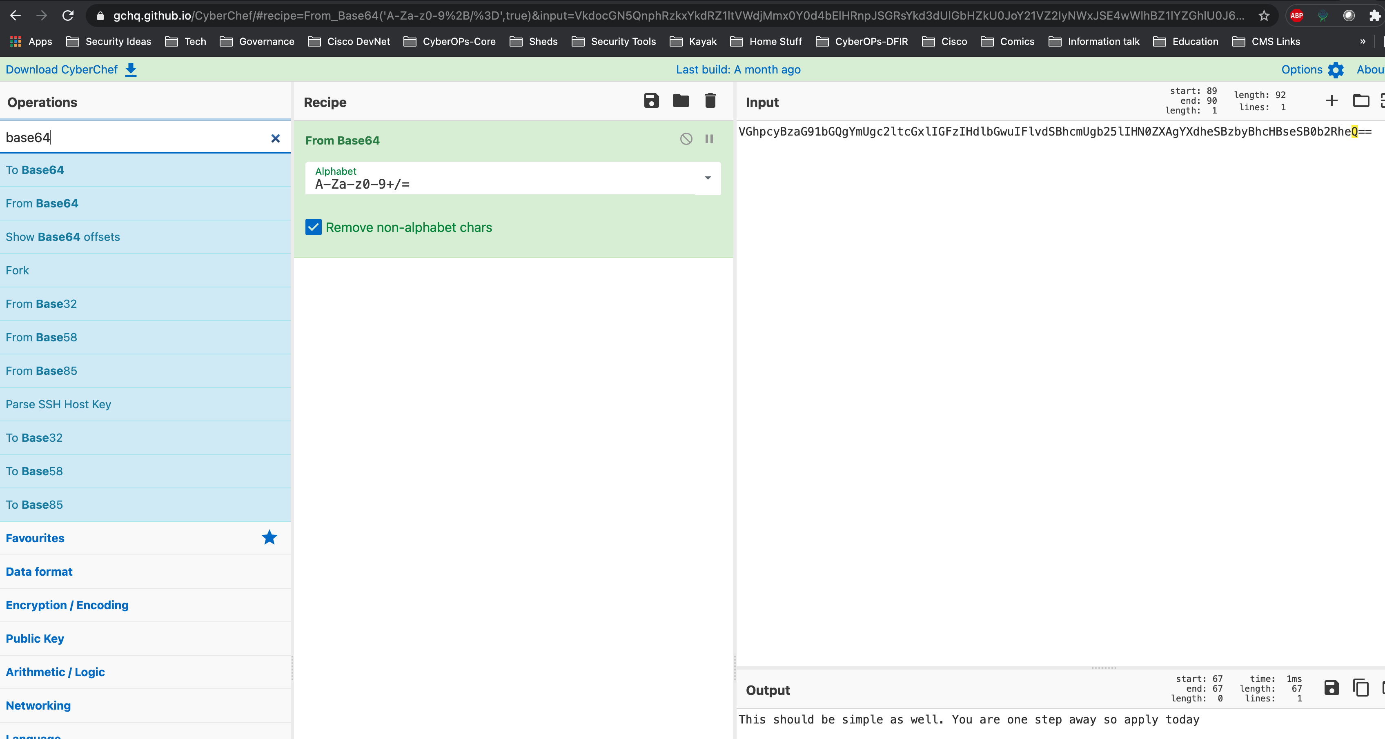
Looking at the Job Description strange new world

Slide 14
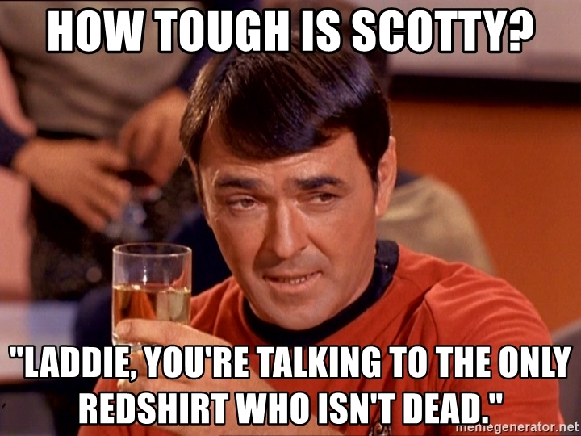
Ok, but fake it till you make it only goes so far
Notes:
https://www.pcgamer.com/helldivers-2-xp-farm/

Slide 15
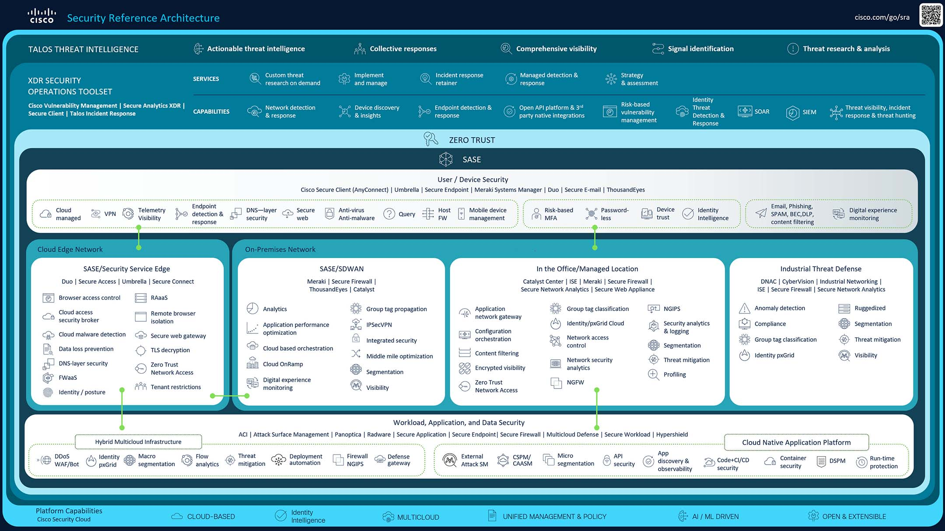
Listen to every word, research everything you don’t know
Notes:
https://pauljerimy.com/security-certification-roadmap/
https://www.cisco.com/c/en/us/products/security/cisco-security-reference-architecture.html#~overview

Slide 16
Make a routine
Spend 30 minutes a day researching something
Catch up on the news every day in that industry
Each day learn a little more some long-term goal
Challenge whether each area body of knowledge in an industry is useful. (Research what certifications will teach you, then see if it’s being used in Job Descriptions or comes up in mentorship conversations)
Notes:
https://www.pcgamer.com/helldivers-2-xp-farm/

