Slide 1
Job Seekers Checkup
Elizabeth Cole-Walker
eacolewa@ncsu.edu
NC State Security and Risk Assurance
March 2024

Slide 2
What is your digital image?
LinkedIn
Resume(s)
Elevator Pitch
Digital Footprint
Job Platforms
Social Media

Slide 3
LinkedIn Profile and Use
Do you have a professional looking headshot?
Do you have a brief description?
Do you have endorsements?
Do you have marketing posts?
Do you share articles and resources?
What groups do you belong to?
Do you have a general resume?
Are your skills fine tuned?
Are your certifications and trainings up to date?
What are your public profile settings?
Do you have tailored resumes for specific job applications?

Slide 4
Resume(s)
Add LinkedIn profile
Dedicated email for job search
Only include supporting and relevant information (remember you have LinkedIn to provide more)
Needs to be easy to read
Can all important information be found quickly
Customize to each post
Proof reading is critical
Only list relevant certifications
Use supportive references
Be concise and use an active voice

Slide 5
Elevator Pitch
Brief summery of who you are and what you do (or are trying to do)
Best to include what you can do (bring to the table) instead of what you want
No longer then 30 seconds
Designed to spark action from the listener
Elements are who you are, what you do or want to do, what’s unique about you, and what your “ask” is
https://www.theforage.com/blog/basics/elevator-pitch
https://www.clearvoice.com/resources/elevator-pitch-job-interview/

Slide 6
Digital Footprint
Use different browsers to search yourself
Try to correct errors and remove negative information
Confirm settings for social media are private as applicable
Check your credit reports
Sanitize pictures
Don’t overshare your information
backgroundchecks.org/justdeleteme
usa.gov/credit-reports
wired.com/story/delete-yourself-from-internet
zdnet.com/article/how-to-delete-yourself-from-internet-search-results-and-hide-your-identity-online

Slide 7
Job Platforms
Company websites
LinkedIn (cost business to post job)
Indeed (great for data mining and research)
CareerBuilder
Simply Hired (best for entry level)
ZipRecruiter (cost business to post job; best for entry level)
https://careersidekick.com/tools/job-search-websites

Slide 8
Social Media
Check up on All social media sites – ensure they support your job search not hinder
Avoid posting any derogatory or offensive content
Be careful about the people or groups followed
Check privacy settings to limit what can be seen
Limit your network and connections
FTC – If you are denied a job due to background check they must provide a copy
hbr.org/2021/09/stop-screening-job-candidates-social-media
themuse.com/advice/45-things-to-do-on-social-media-to-find-jobs

Slide 9
If you are not getting the response you want, you may need to change what you are doing. Don’t be afraid to ask for help!

Slide 10
Career Services Support Team
Tom Purdy tepurdy@att.net
Chris Uhlig chris.uhlig@disys.com
Elizabeth Cole-Walker eacolewa@ncsu.edu
Jon Lee me@jonlee.us
Even Strickland tacituacitum@gmail.com
Debra Farris digferris@bellsouth.net
Dan Greenhaus dangreenhous@gmail.com

Slide 11
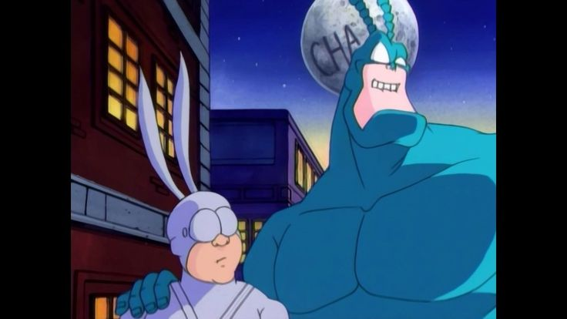
Career Service Resources
Chapter Website https://raleigh.issa.org/meetings/career-services
Chapter LinkedIn https://www.linkedin.com/company/issa-raleigh-chapter
Chapter Facebook https://www.facebook.com/groups/raleighissa
Chapter Twitter Https://twitter.com/raleighissa
Discord –> Channels –> Raleigh ISSA –> Jobs https://discord.com/channels

