Slide 1
The State of the Job Market Today
April 6, 2023
Presented by Chris Uhlig
Senior Account Executive, DISYS

Slide 2
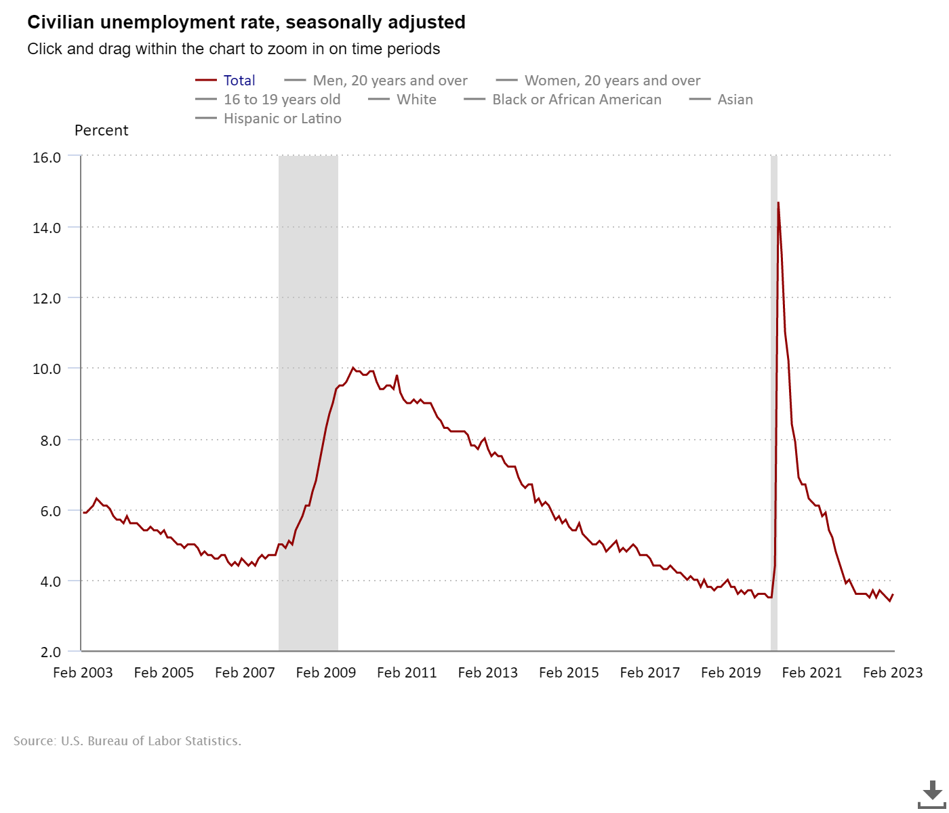
BLS Market Data
Number of job losses and persons who completed temporary jobs increased by 223,000 in February to 2.8 million.
In February, the information industry lost 25,000 jobs. Employment in the “information” sector decreased by 54,000 since November 2022.
Employment in “professional and business services” trended up in February (+45,000), with 12k accounted for by management, scientific and consulting services.
Employment in professional and business services had increased by an average of 35,000 per month over the prior 6 months.
Notes:
Source: https://www.bls.gov/news.release/pdf/empsit.pdf

Slide 3
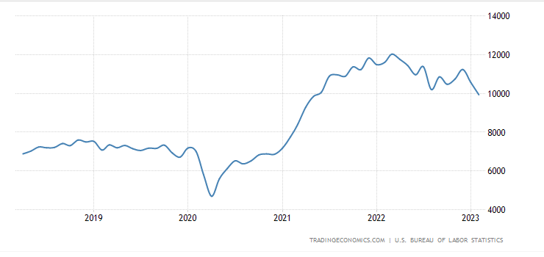
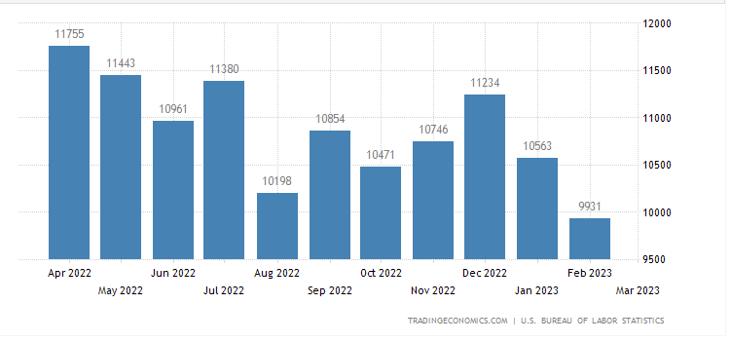
Some More Charts
Notes:
The number of job openings in the United States fell by 632,000 to 9.9 million in February 2023, the lowest level since May 2021 and below market expectations of 10.4 million signaling the labor market might have started cooling. Over the month, the largest decreases in job openings were in professional and business services (-278,000); health care and social assistance (-150,000); and transportation, warehousing, and utilities (-145,000). On the other hand, the number of job openings increased in construction (+129,000) and in arts, entertainment, and recreation (+38,000). Meanwhile, the number of hires and total separations changed little at 6.2 million and 5.8 million, respectively. Within separations, quits (4.0 million) edged up, while layoffs and discharges (1.5 million) decreased. source: U.S. Bureau of Labor Statistics
https://tradingeconomics.com/united-states/job-offers

Slide 4
JOLTS
The Bureau of Labor Statistics tracks the number of job openings, hires, layoffs, quits, and other separations of employment. This is called the “JOLTS” (Job Opening and Labor Turnover Summary).
This data is a lagging indicator (most recent data is from January of 2023).
Layoffs and discharges were concentrated most heavily in business and professional services (190k+ layoffs).
Quits decreased by 207,000 in January.
Notes:
https://www.careercloud.com/news/current-state-of-the-job-market
“A Federal Reserve survey of nearly 8,000 small businesses found the top operational challenge was hiring or retaining qualified staff, ahead of growing sales and reaching new customers. About 40% of businesses said they attempted to hire new workers and it was very difficult — far more than the 27% of businesses that said the same thing in 2018.
Overall, about 72% of firms facing hiring challenges said they had too few applicants, while 62% said the applicants they did get lacked job-specific skills or experience.
Richard Wahlquist, president and CEO at the American Staffing Association, said the effects of the Federal Reserve’s rate hikes were finally showing themselves, and while job openings dropped, there were still nearly two job openings for every unemployed person. ”
https://www.bizjournals.com/triangle/news/2023/04/05/jobs-hiring-labor-market-layoffs-openings.html

Slide 5
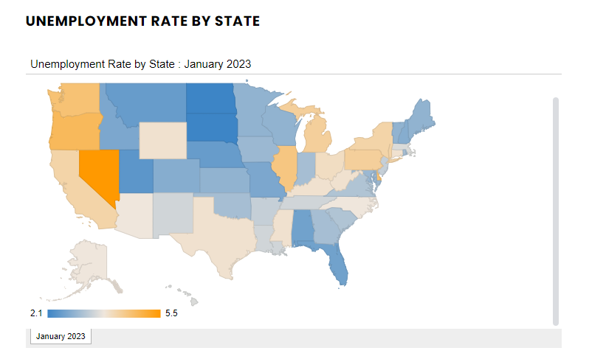
National Unemployment vs. North Carolina
January 2023 Unemployment Rate for North Carolina: 3.8%
This represents a .2% increase over the past 12 months.
Notes:
https://www.careercloud.com/news/current-state-of-the-job-market

Slide 6
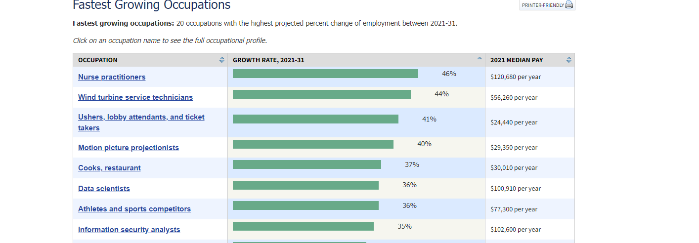
Employment of information security analysts is projected to grow 35 percent from 2021 to 2031, much faster than the average for all occupations.
Notes:
https://www.bls.gov/ooh/fastest-growing.htm
https://www.bls.gov/ooh/computer-and-information-technology/information-security-analysts.htm

Slide 7
Remote Work Trends
Let’s dive in

Slide 8
“Before the pandemic about 75% of our people were in the office on any given day of the week. Today it’s about 65%, so we’re kind of operating close to the way we were”
David Solomon, Goldman Sachs CEO

Slide 9
“We anticipate never going back to five days a week in the office”
Alan Jope, Unilever CEO

Slide 10
“Remote work is no longer acceptable… anyone who wishes to do remote work must be in the office for a minimum (and I mean *minimum*) of 40 hours per week or depart Tesla”
Elon Musk, Tesla CEO

Slide 11
“We’ll move to a hybrid work week where most Googlers spend approximately three days in the office and two days wherever they work best”
Google CEO, Sundar Pichai

Slide 12
Some Remote Work Statistics
Over 4.7 million people work remotely at least 50% of the time.
16% of companies hire remote only workers.
87% of employees will choose remote work options when offered.
Nearly 60% of employers identify cost savings as a significant telecommuting benefit.
About 60% of employers who allowed remote work during the pandemic plan to keep those options available, according to the Bureau of Labor Statistics
An Owl Labs Survey found that about 44% of companies do not allow remote work
Notes:
https://www.apollotechnical.com/statistics-on-remote-workers/
https://slack.com/blog/collaboration/workplace-transformation-in-the-wake-of-covid-19
https://www.mckinsey.com/industries/real-estate/our-insights/americans-are-embracing-flexible-work-and-they-want-more-of-it
https://www.shrm.org/resourcesandtools/hr-topics/talent-acquisition/pages/many-employers-some-remote-work-expected-to-last.aspx

Slide 13
Summary
Hiring Has Declined
The data indicate the number of open jobs has dropped when compared to the same period in 2022.
Growth of Information Security Jobs is Expected to Continue
The BLS projects a 35% increase in open information security analyst jobs from 2021-2031.
Less People Are Leaving Their Jobs
BLS Data suggests that “The Great Resignation” of 2022 is coming to an end with resignations seeing a sharp decline.
Competition for Remote Work is High
The demand for fully remote positions is high, and supply has dwindled. This means that employer expectations are often higher for these positions.
Remote Work Continues
Although trends indicate many companies returning to the office in some capacity, remote options remain available for many employees.
“Perkcession”
Many employers are cutting back on perks as they look to optimize costs.
Notes:
https://www.wsj.com/articles/the-perk-cession-is-under-way-at-some-companies-9cb04e9c

Slide 14
Questions?

Slide 15
Raleigh ISSA Career Services
Chris Uhlig – Chris.Uhlig@disys.com
Elizabeth Cole-Walker – elizabeth.colewalker2@gmail.com
Evan Strickland – tacituacitum@gmail.com
Jon Lee – me@jonlee.us
Tom Purdy – tepurdy@att.net
ISSA Raleigh Chapter Career Service Resources
Website → Membership Career Services → https://raleigh.issa.org/career-services/
LinkedIn → https://www.linkedin.com/company/issa-raleigh-chapter
Facebook → https://www.facebook.com/groups/raleighissa/
Twitter → https://twitter.com/RaleighISSA

